Slide 1
Team Alpha Update
November 13, 2023

Slide 2
Lines of Code Generated:
265!

Slide 3
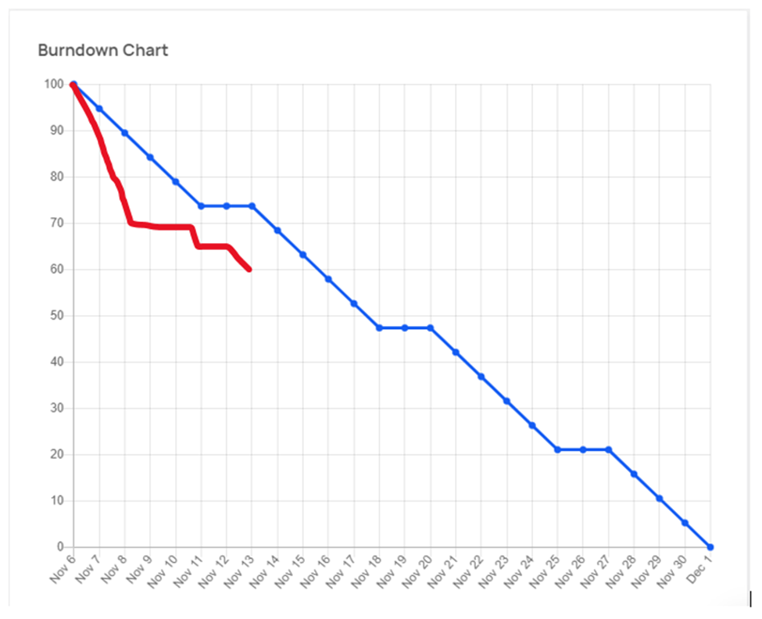
Burndown Chart

Slide 4
Features Update:
Multi-Factor Authentication (MFA)
reCAPTCHA
User Signup
User Login
Outline for a page’s version history

Slide 5
4 Users Pre-ordered Subscriptions!

